Slide 1


CASTRA: Context Aware Security Technology for Responsive and Adaptive Protection
Dr. Devu Manikantan Shila| United Technologies Research Center
July 13 2017

Slide 2

CASTRA
Design
Experiment Design & Validation
Android & Cloud Implementation
Transition
Data Analytics & Fusion
Team Profile
Extensive expertise in
Cyber physical system security
Big data analytics
Real-time information fusion
Cloud computing
Devu Manikantan Shila (PI)
Kunal Srivastava
Kishore Reddy
Kin Lore-Gwn
Paul O’Neill
Teems Lovett
Kermel Ruperto
Steve Uhl
Tiwari Ankit

Slide 3


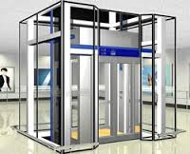
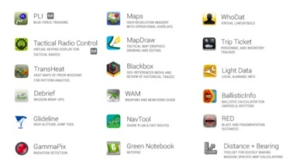
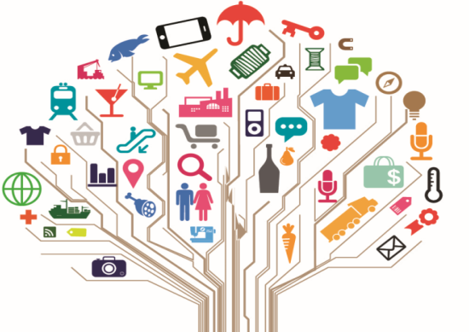
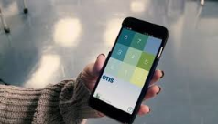
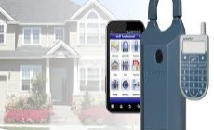
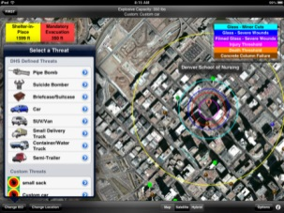
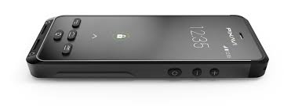
Customer Need
Design secure, user-friendly and continuous authentication for smartphones
Smartphone
Universal Remote Control
Smartphone applications
Service technician tools
Leverage smartphone as a service tool
Application in building and aerospace domains
Military
Multiple applications… training soldiers to enhancing security
the “gateway to diverse mobile services”
Billions of devices will be interconnected in future
Security and trust – the vital element of the Internet of things
IoT control hub
Critical services for
Identity & Authentication
Access to Various IoT
First responders
Access to critical map-based information

Slide 4
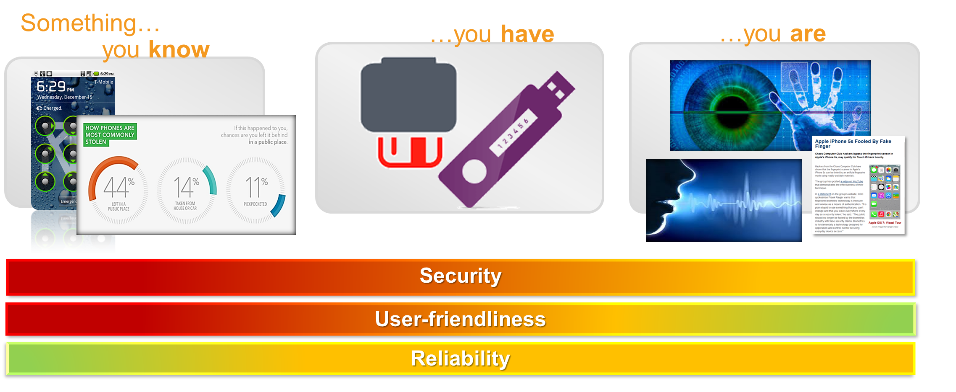
Customer Need
Hard to realize user-friendliness, security and reliability for existing schemes

Slide 5




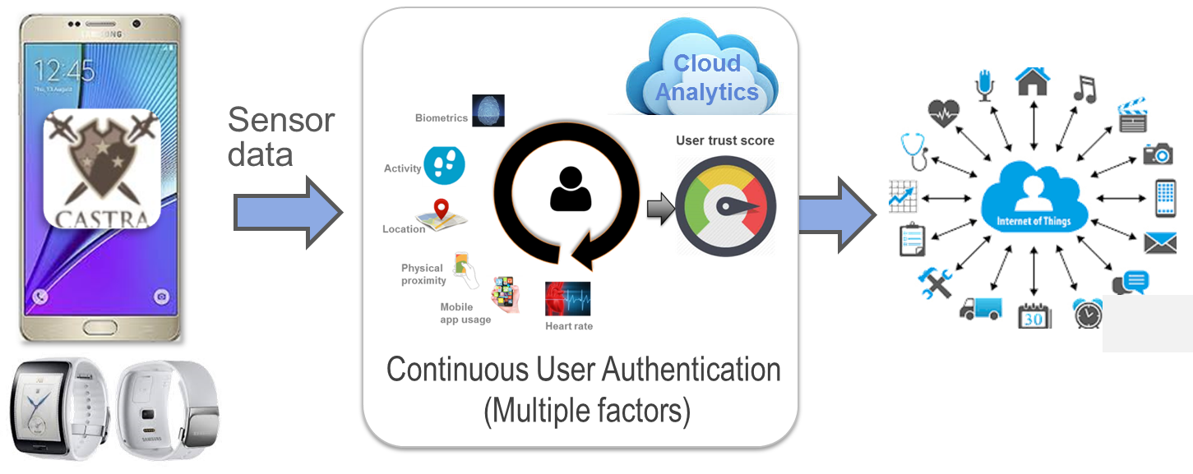
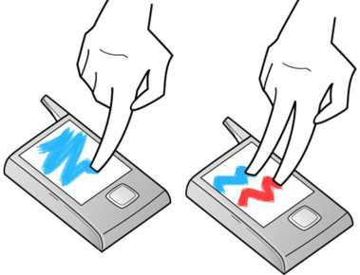
Technical Approach
A multi-faceted, continuous authentication technology for smartphones
CASTRA architecture
Behavioral biometrics
Leverages analytics on mobile sensor data to learn various human behavioral traits – Gait, location, proximity, app usage, etc.
Three key elements
Multi-faceted authentication…Secure and reliable
Continuous authentication ...User-friendliness
Risk-based seamless access control…User-friendliness
Recognize user based on interactions with the device
Leverages sensors embedded in smartphones

Slide 6

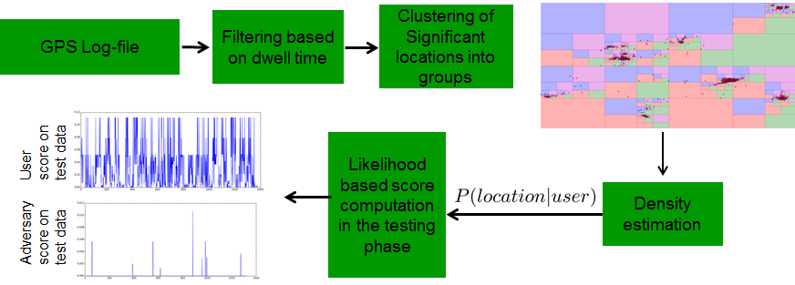
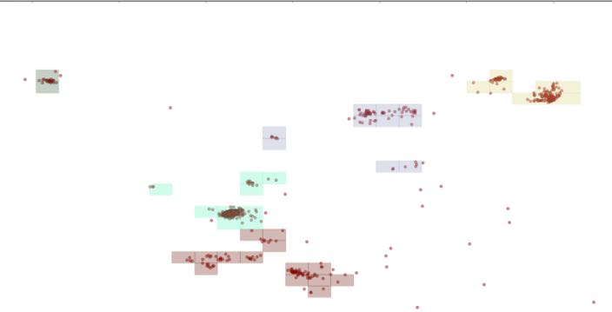
CASTRA: Learning from location
Leveraging Quad-Trees and K-Means
Computes the user trust score based on the “most frequently visited places”
High score for frequently visited places and low score for unseen places
Two steps to learn user location model
Quad tree
K-Means clustering on the centroids of the leaves of the quad tree
GPS score is computed as follows
S_{location}= P(location | time, user)
Steps involved from GPS logs to learning models
Clustering of leaves using K-Means

Slide 7

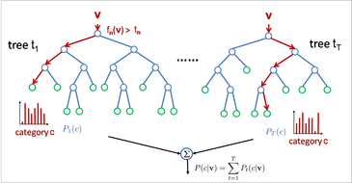
CASTRA: Learning from proximity
Supervised learning framework
Proximity used to extend the validity of initial biometrics (first noted by O. Riva et. al)
Learns whether the device is in contact with the user or not (reduce trust score when on table)
Uses supervised learning framework to understand whether the device is in contact or not
Feature Extraction
Accelerometer
Gyroscope
Magnetometer
Proximity sensor
Label – on table or in pocket
Log
Energy
Binned
Histogram
Moving window segmentation ~ 15 s
Mean
Time Series Classifier Training Outline:
103 features
 | Device On Table | Device In-Pocket
Device On Table | 90.6% | 9.4%
Device In-Pocket | 8.6% | 91.4%
Supervised Classifier Training – (Random Forest)
Confusion matrix for the test dataset

Slide 8
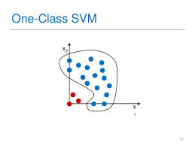
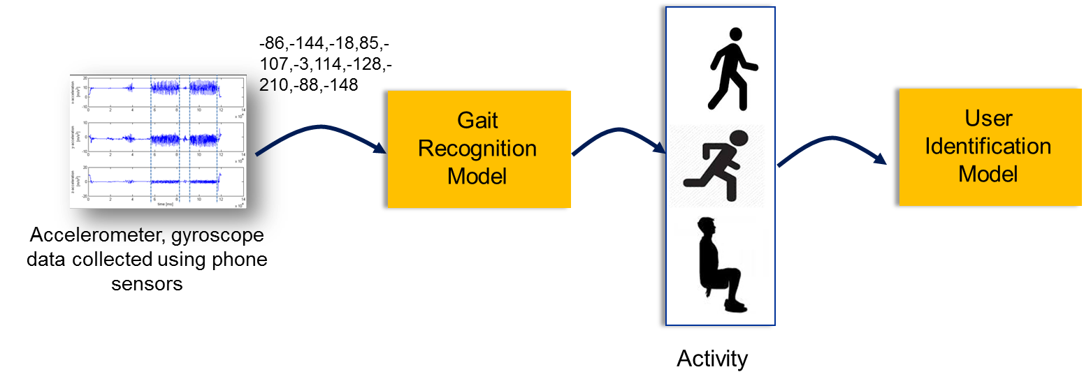
CASTRA: Learning from walking
Unsupervised learning framework
Existing efforts on gait based identification is based on supervised learning framework
Uses one class SVMs that learns a nominal model of user from the training data set
Uses Google Play Services Activity Recognition API to automatically label the data with the activity and extract walking samples > 75% confidence
Walking features
(92 features)
Leverages Google Activity recognition API

Slide 9
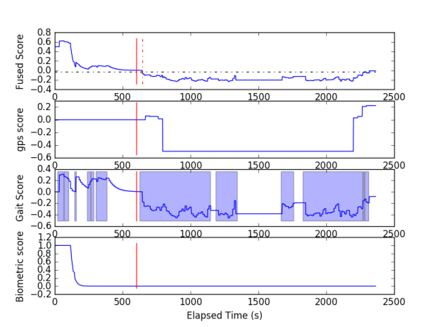
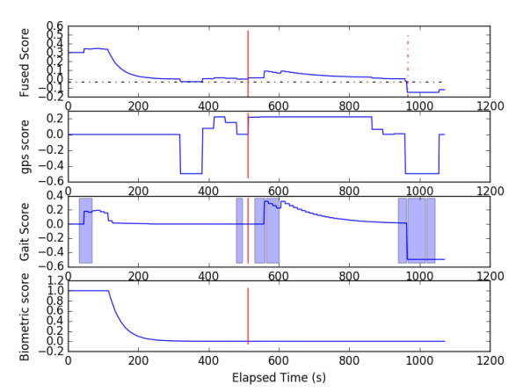
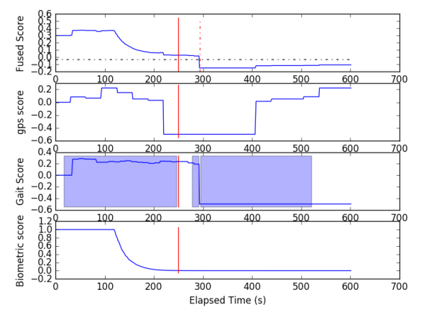
CASTRA: Offline Evaluation of ML
Detection latency
Implemented sensor tracking app in Android
Several experiments were designed to collect nominal user data
Continuous verification around 10s
Proof of Concept – Three attack scenarios were designed
Key Observation – cannot detect attacker when the phone is fully authenticated, in trusted location and idle but limited time period only (e.g., handover)
Can be resolved by adding authentication modes such as touch dynamics or facial recognition
Attack scenario 1
Attack scenario 2
Attack scenario 3

Slide 10
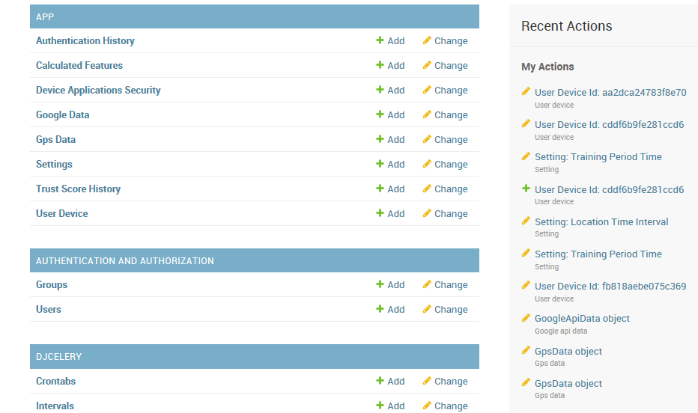
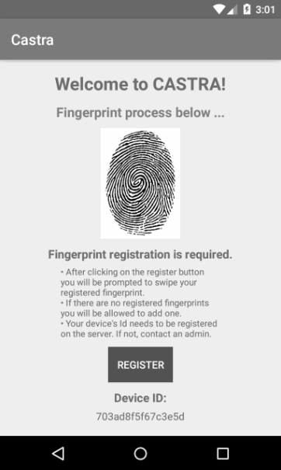
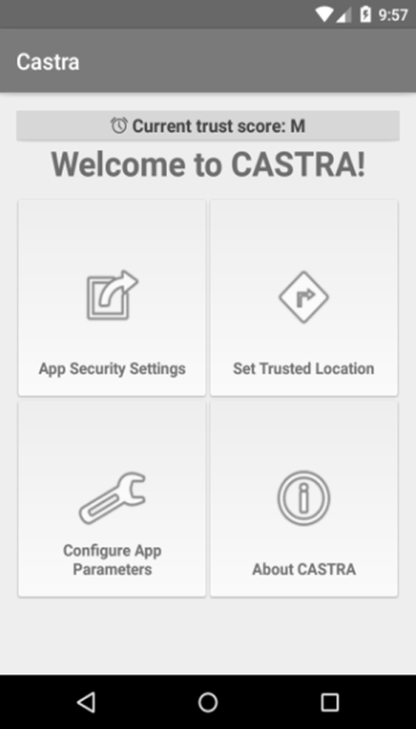
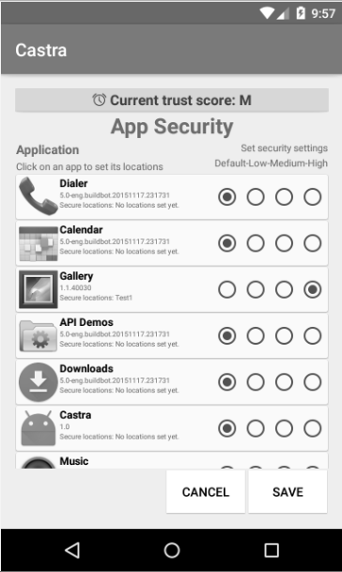
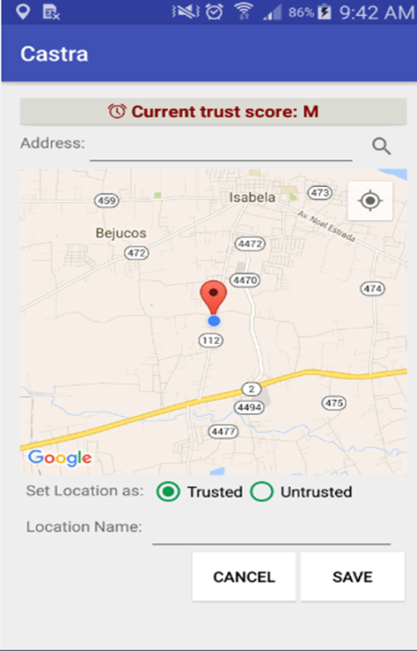

CASTRA Current State
Machine learning algorithms are provided as Cloud services (Amazon Cloud)
Feature extractions and Risk manager implemented in Android
Many modifications to reduce battery and data rate issues
CASTRA Cloud Services
Configure various thresholds

Slide 11
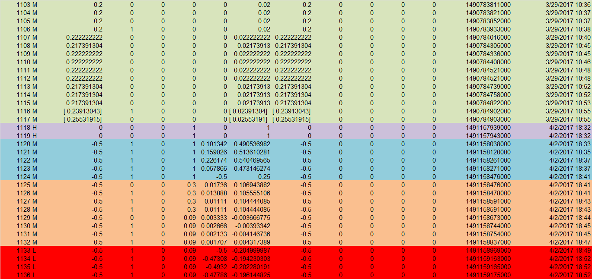
CASTRA Results
CASTRA app trained and tested in different locations
Test on Trained location
Biometric
In contact
Gait
On Table
Gait
Under attack
Trust Score
Location
Score
Fused
Score
Biometric/Proximity Score
Gait
Score

Slide 12

CASTRA DEMO

Slide 13
Benefits
User-friendly authentication
Multi-faceted approach to protect sensitive resources from unauthorized hands and untrusted mobile apps
Context-aware adaptive access to apps based on policies, app sensitivity and trust score
Continuous authentication
Multiple applications (besides authentication)

Slide 14

Potential Transition Activities
Publications:
A multi-faceted approach to user authentication for mobile devices – using human movements, location and proximity, D.M. Shila, K. Srivastava, P. O’Neil, K. Reddy, V. Sritapan
CASTRA: Seamless and Unobstrusive Authentication of Users to Diverse Mobile Services (In submission), D. M. Shila, K. Srivastava, P. O’Neill, E. Eyisi, T. Lovett, V. Sritapan
Invited Talks (Multiple)
Invention Disclosures / Patents
Two Invention Disclosures
1 patent filed: System and method of mobile based user authentication for an access controlled environment
Transition Activities
Open source (In discussion)
Frictionless Authentication for IoTs

Slide 15

Contact Info
Dr. Devu Manikantan Shila, Ph.D.
Principal Research Scientist
manikad@utrc.utc.com
860-610-7198
www.dmsanalysis.com

Slide 16


2017 Cyber Security
R&D Showcase and Technical Workshop
July 11 - 13, 2017 | Washington, D.C.

